Slide 1


Dominic Garzoli
November 30, 2021

Slide 2

Outline
Executive Summary
Introduction
Methodology
Results
Conclusion
Appendix

Slide 3
Executive Summary
Summary of methodologies:
Collecting data
Data wrangling
Exploratory analysis using SQL
Exploratory analysis using Pandas and Matplotlib
Visual analytics and building dashboards with Plotly Dash
Predictive analysis
Building a map using folium
Summary of all results:
Exploratory data analysis results
Folium map results
Interactive dashboard made with Plotly (screenshots)
Predictive analysis results

Slide 4
Introduction
Project background and context
We were predicting if the Falcon 9 first stage will land successfully. Space X can reuse the first stage of the rocket if it lands successfully, which results in huge savings. Other providers cost more than $165 million for each rocket launch, whereas Space X advertises a cost of only $62 million. Therefore, if we can determine if the first stage will land, we can also determine the cost of launching a rocket.
Problems you want to find answers
What are the factors that determine if a rocket lands successfully?
What are the optimal conditions to launch a rocket for the best chance of a successful landing?
What are the common issues in all rocket landing failures?
How do all the components of a rocket launch affect/relate to one another?

Slide 5


Slide 6
Methodology
Executive Summary
Data collection methodology:
SpaceX API using a URL that was given in the lab
Web Scraping using Wikipedia link
Performed data wrangling
Utilized one hot encoding to prepare the data for Machine Learning, and removed unnecessary columns
Performed exploratory data analysis (EDA) using visualization and SQL
Performed interactive visual analytics using Folium and Plotly Dash
Performed predictive analysis using classification models
Standardized data, split it into training and test data, and found the best hyperparameter for SVM, Classification Trees, and Logistic Regression

Slide 7
Data Collection
We utilized data that was collected from the Space X API (link was given in the lab: https://api.spacexdata.com/v4/launches/past).
This Space X data contains information such as booster name, launch site, payload mass, landing outcome, number of flights with that core, and much more.
We also utilized BeautifulSoup for web scraping from a Wikipedia page (link was given in the lab: https://en.wikipedia.org/wiki/List_of_Falcon\_9\_and_Falcon_Heavy_launches).
Space X API
Web Scraping From Wikipedia
Use the Space X API with the link given
Returns all the Space X data in JSON format
Normalize the data into a Pandas Data frame
Extract the table from Wikipedia using BeautifulSoup
Normalize and parse data into a Pandas Data frame
Get link for HTML table in Wikipedia

Slide 8
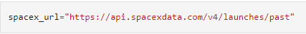
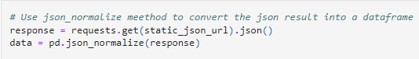
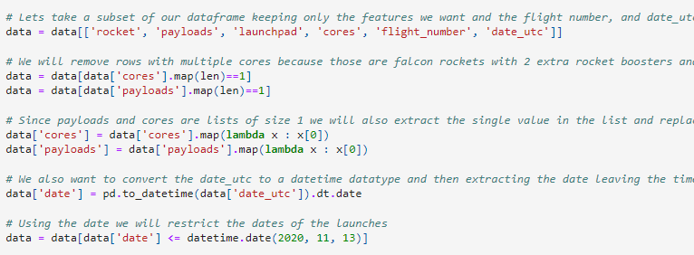
Data Collection – SpaceX API
Use the Space X API with the link given
Returns all the Space X data in JSON format
Normalize the data into a Pandas Data frame
1. Access the Space X data using API
2. Normalize data into Pandas DF
3. Clean and remove unnecessary data
4. Export to a CSV File
datasciencecapstone/SpaceX Data.ipynb at Master · DGarzoli4/datasciencecapstone (github.com)

Slide 9
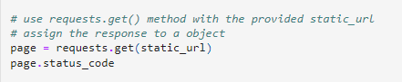
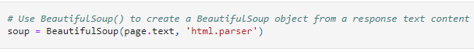
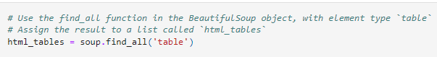
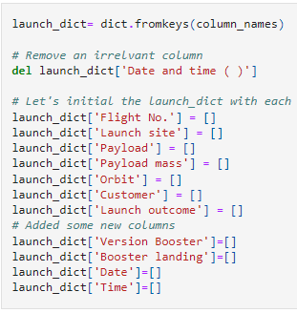
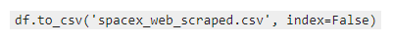
Get link for HTML table in Wikipedia
Extract table from Wiki using BeautifulSoup
Normalize and parse data into a Pandas Data frame
Data Collection - Scraping
1. Get Falcon9 Launch HTML page
2. Create a BeautifulSoup object
3. Finding all the tables in the wiki page
4. Create dictionary and convert to dataframe
5. Export dataframe to CSV file
datasciencecapstone/Web Scraping.ipynb at Master · DGarzoli4/datasciencecapstone (github.com)

Slide 10
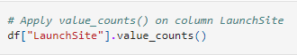
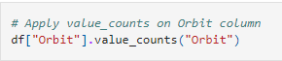
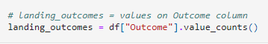
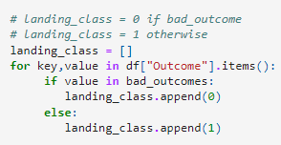
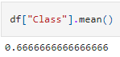
Data Wrangling
Background
In the data set, there are several different cases where the booster did not land successfully. Sometimes a landing was attempted but failed due to an accident; for example, True Ocean means the mission outcome was successfully landed to a specific region of the ocean while False Ocean means the mission outcome was unsuccessfully landed to a specific region of the ocean. True RTLS means the mission outcome was successfully landed to a ground pad False RTLS means the mission outcome was unsuccessfully landed to a ground pad. True ASDS means the mission outcome was successfully landed on a drone ship False ASDS means the mission outcome was unsuccessfully landed on a drone ship.
Goal of Data Wrangling
To convert those outcomes into Training Labels with 1 meaning the booster landed successfully, and 0 meaning it was unsuccessful.
1.
2.
3.
1. Calculate the number of launches on each site
2. Calculate the number and occurrence of each orbit
3. Calculate the number and occurrence of mission outcome per orbit type
4. Create a landing outcome label from Outcome column
5. Determine success rate of landing
6. Export to CSV file
4.
5.
6.
datasciencecapstone/Data Wrangling.ipynb at Master · DGarzoli4/datasciencecapstone (github.com)

Slide 11
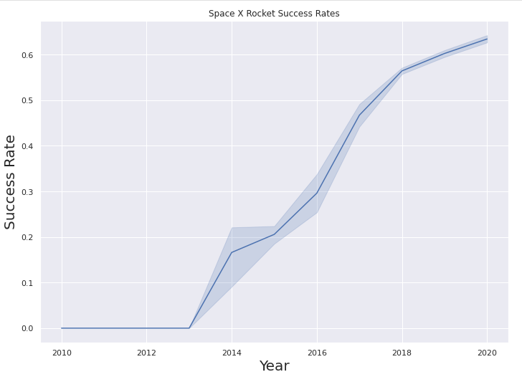
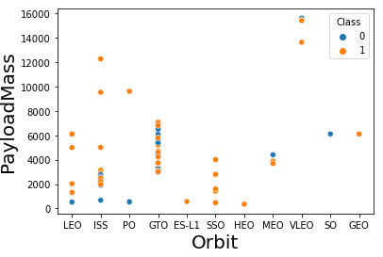
EDA with Data Visualization
Scatter Plots
Flight Number vs. Payload Mass
Flight Number vs. Launch Site
Payload vs. Launch Site
Flight Number vs. Orbit Type
Payload vs. Orbit Type
Line Chart
Success rate vs. Year
The purpose of a scatterplot is to show the relationship between two variables, which is called their correlation.
The purpose of a line chart is typically to show trends over time.
datasciencecapstone/Data Viz.ipynb at Master · DGarzoli4/datasciencecapstone (github.com)

Slide 12
EDA with SQL
Display the names of the unique launch sites in the space mission
Display 5 records where launch sites began with the sting ‘CCA’
Display the total payload mass carried by boosters launched by NASA (CRS)
Display the average payload mass carried by booster version F9 v1.1
List the date when the first successful landing outcome in ground pad was achieved.
List the names of the boosters which have success in drone ship and have payload mass greater than 4000 but less than 6000
List the total number of successful and failure mission outcomes
List the names of the booster_versions which have carried the maximum payload mass. Use a subquery
List the failed landing_outcomes in drone ship, their booster versions, and launch site names for in year 2015
Rank the count of landing outcomes (such as Failure (drone ship) or Success (ground pad)) between the date 2010-06-04 and 2017-03-20, in descending order

Slide 13
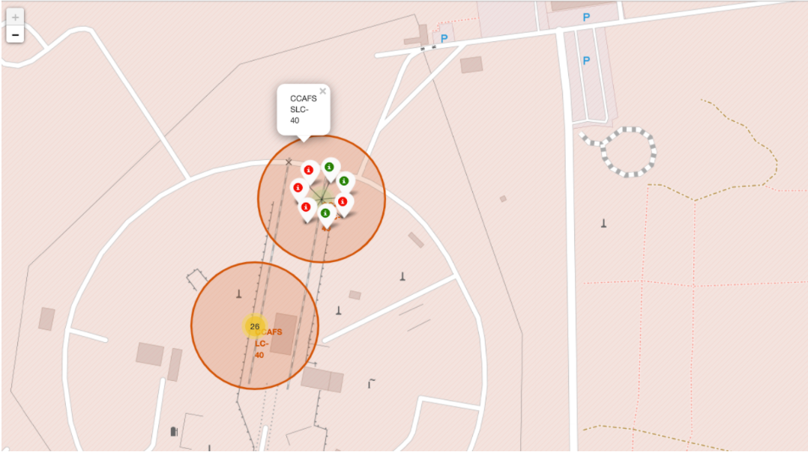
Build an Interactive Map with Folium
In order to visualize launch sites, we created an interactive map with circles around each launch site and included the name of each site.
We added these objects to mark the success/failed launches, and to calculate the distance between a launch site to its proximities.
It is important to know how far away launch sites are from railways, highways, coastlines, cities, etc.
datasciencecapstone/Folium Lab (1).ipynb at Master · DGarzoli4/datasciencecapstone (github.com)

Slide 14
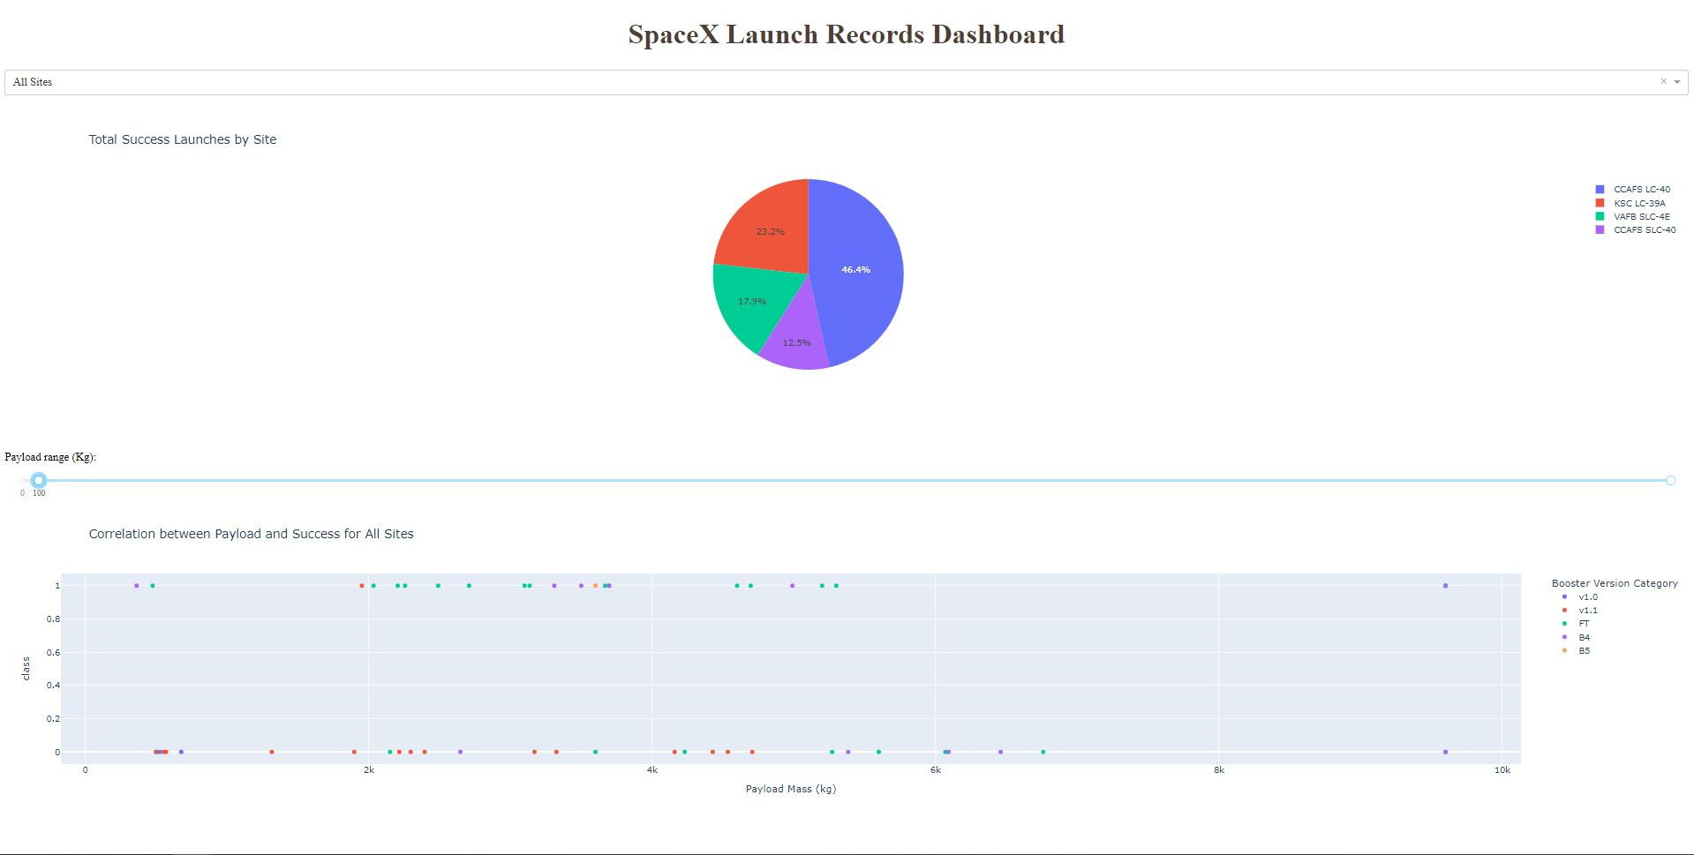
Build a Dashboard with Plotly Dash
I have added a pie chart of total successful launches by site with a dropdown that allows you to select different sites
I have also included a scatter plot of the correlation between payload and success for all sites with a slider that allows you t select different payload ranges.
I added these plots and interactions so you can easily determine which sites and payload ranges result in the most successful rocket launches.
datasciencecapstone/spacex_dash_app (2).py at Master · DGarzoli4/datasciencecapstone (github.com)

Slide 15
Predictive Analysis (Classification)
Building model
Load the data
Standardize (transform) the data
Split the data into a training and testing set
Create logistic regression object and set parameters
Train the data set
Evaluating model
Evaluate the accuracy of the model
Set specific hyperparameters for each algorithm
Plot a confusion matrix
Improving model
Constant tweaking of algorithm
Continuous improvement
Finding the best performing classification model
The model that results in the highest accuracy is the best performing model
datasciencecapstone/week 4 project (1).ipynb at Master · DGarzoli4/datasciencecapstone (github.com)

Slide 16
Results
Exploratory data analysis results
Interactive analytics demo in screenshots
Predictive analysis results

Slide 17


Slide 18
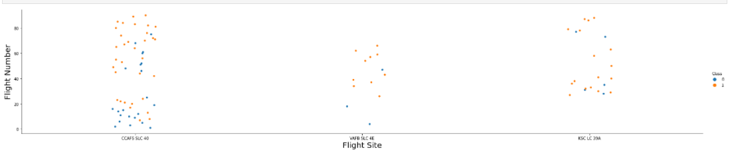
Flight Number vs. Launch Site
The sites with a greater number of launches have a higher rate of successful launches

Slide 19
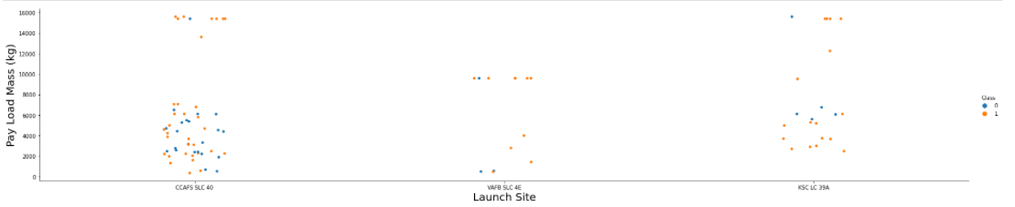
Payload vs. Launch Site
It is tough to draw concrete conclusions with this visual because some launch sites have more success with a heavier payload (CCAFS SLC 40), whereas other launch sites have more success with a lighter payload (KSC LC 39A)

Slide 20
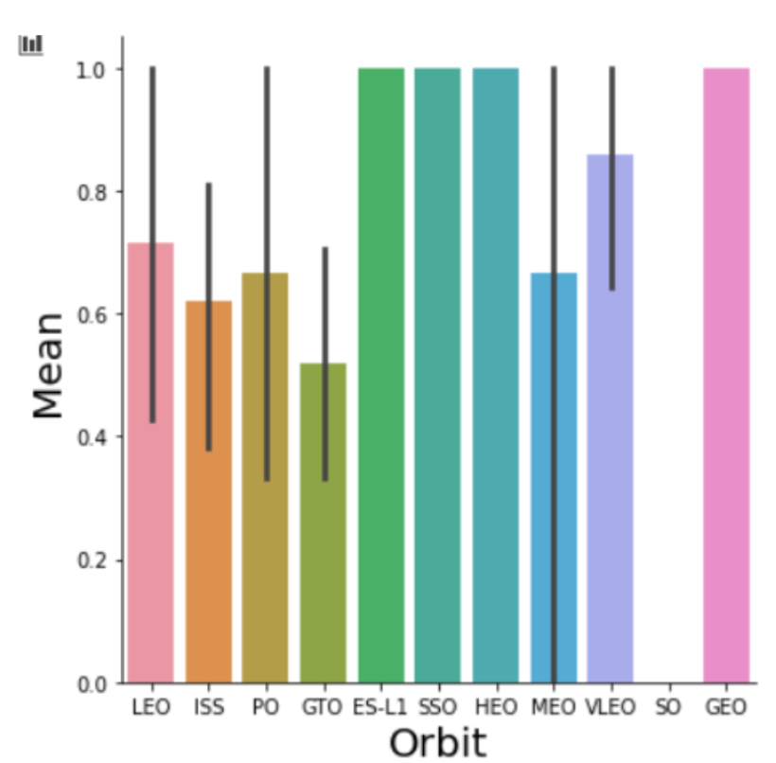
Success Rate vs. Orbit Type
The Orbit Types with the best average success rates are ES-L1, SSO, HEO, and GEO.

Slide 21
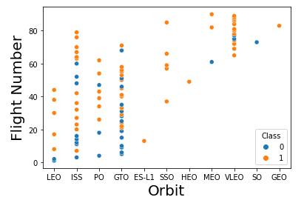
Flight Number vs. Orbit Type
ES-L1, SSO, HEO, and GEO do not have many data points, but they are all successful launches. LEO orbit success tends to depend on flight number, whereas the other orbits are tough to determine a pattern

Slide 22
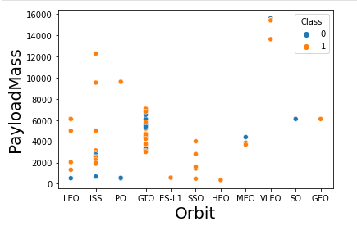
Payload vs. Orbit Type
Heavier loads tend to be beneficial to LEO and ISS orbits, whereas they hinder GTO and MEO orbits

Slide 23
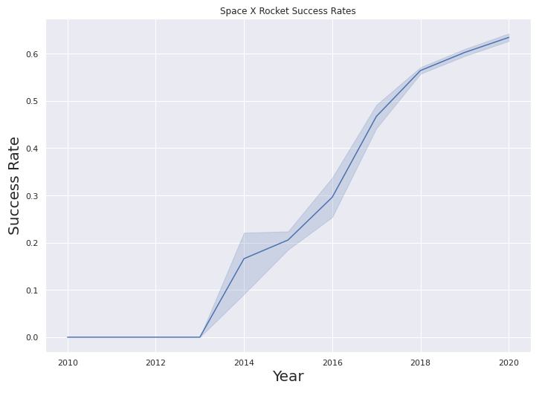
Launch Success Yearly Trend
Success rate has been increasing every year from 2013 to 2020

Slide 24
All Launch Site Names
Using DISTINCT in the query only returns the unique values in the column “Launch_Site” from the SpaceX table

Slide 25
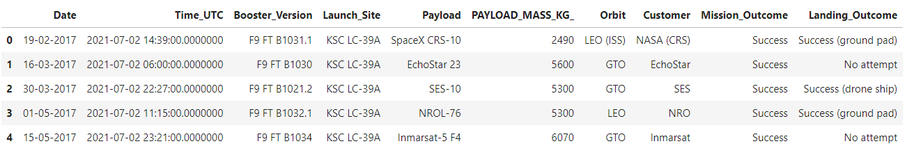
Launch Site Names Begin with ‘KSC'
The words “Top 5” in the query means that the result will only display 5 records from the SpaceX Table. The “LIKE ‘KSC%’” string means that the launch site must start with KSC.

Slide 26
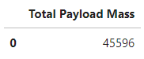
Total Payload Mass
The “SUM” function adds up all the values in the “PAYLOAD_MASS_KG_” column. The “where” function filters the data to only sum values where the customer is NASA (CRS)

Slide 27
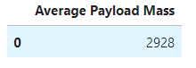
Average Payload Mass by F9 v1.1
The “AVG” function calculates the average of the values in column “AveragePayloadMass”. The “where” function filters the data to only perform calculations on booster version F9 v1.1

Slide 28

First Successful Ground Landing Date
The “MIN” function identifies the earliest date in the date column. The “where” function filters the dataset to only perform calculations on successful landing outcomes.

Slide 29
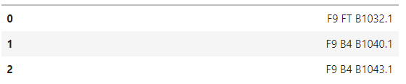
Successful Drone Ship Landing with Payload between 4000 and 6000
("select Booster_Version from tblSpaceX where Landing_Outcome = 'Success (ground pad)' AND Payload_MASS_KG_ > 4000 AND Payload_MASS_KG_ < 6000“)
Returns only booster versions from SpaceX Table with successful ground pads and a payload mass greater than 4000 but less than 6000

Slide 30
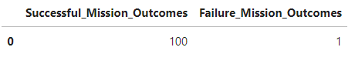
Total Number of Successful and Failure Mission Outcomes
(SELECT Count(Mission_Outcome) from tblSpaceX where Mission_Outcome LIKE '%Success%') as Successful_Mission_Outcomes,(SELECT Count(Mission_Outcome) from tblSpaceX where Mission_Outcome LIKE '%Failure%’)
Returns a Count of successful mission outcomes in SpaceX Table using %Success%.
Returns a Count of failed mission outcomes in SpaceX Table using %Failure%

Slide 31
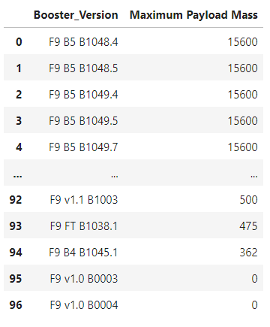
Boosters Carried Maximum Payload
("SELECT DISTINCT Booster_Version, MAX(PAYLOAD_MASS_KG_) AS [Maximum Payload Mass] FROM tblSpaceX GROUP BY Booster_Version ORDER BY [Maximum Payload Mass] DESC")
The “DISTINCT” function returns only unique values in the Booster_Version column. “GROUP BY” groups the data based on the booster version, and “ORDER BY DESC” arranges the results from highest to lowest

Slide 32
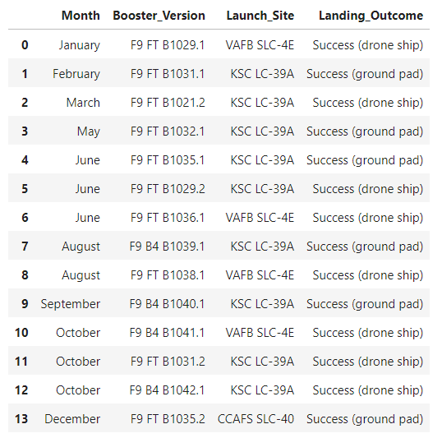
2017 Launch Records
("SELECT DateName( month , DateAdd( month , MONTH(CONVERT(date,Date, 105)) , 0 ) - 1 ) as Month, Booster_Version, Launch_Site, Landing_Outcome FROM tblSpaceX WHERE (Landing_Outcome LIKE N'%Success%') AND YEAR(CONVERT(date,Date, 105)) = '2017'")
Returns Month, Booster_Version, Launch_Site, and successful ground pad Landing_Outcome where the year is 2017

Slide 33
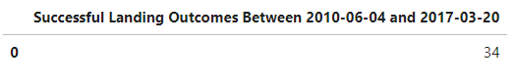
Rank Landing Outcomes Between 2010-06-04 and 2017-03-20
("SELECT COUNT(Landing_Outcome) AS sl FROM dbo.tblSpaceX WHERE (Landing_Outcome LIKE '%Success%') AND (Date >'04-06-2010') AND (Date < '20-03-2017')
Counts the number of landing outcomes with successful landings and a date between June 4th 2010 and March 20th 2017

Slide 34


Slide 35
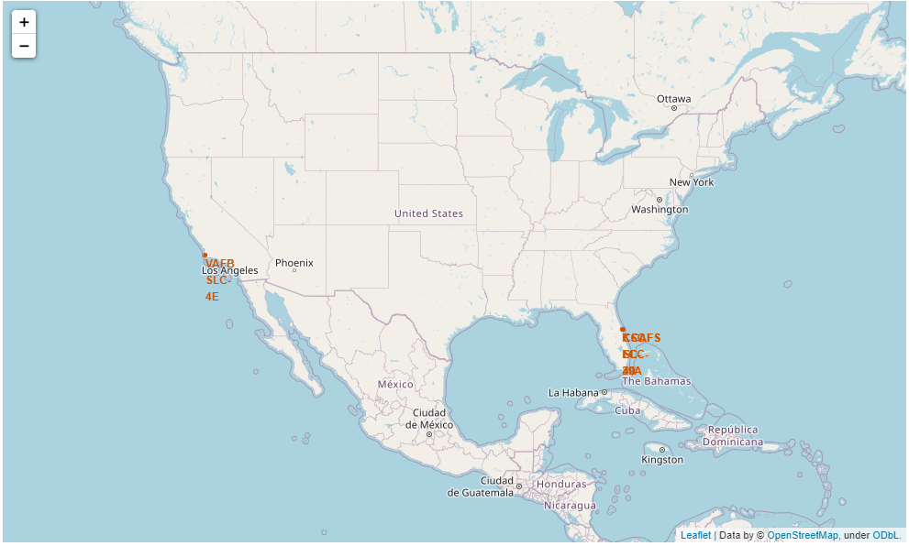
Folium Map With All Launch Sites
All the launch sites are either in Southern California or Florida.
I am assuming it has something to do with the weather always being nice in the two states

Slide 36
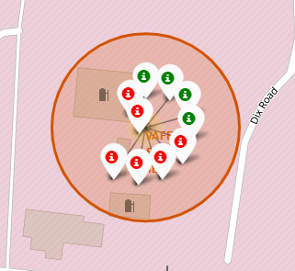
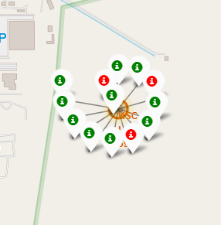
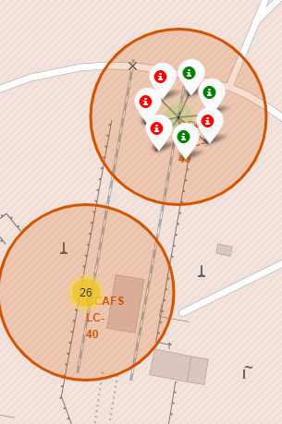
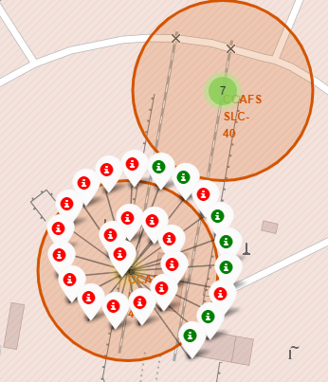
Color Labeled Launch Outcomes
California Launch Site
Florida Launch Sites
The green markers represent successful launches, and the red markers represent failed launches.
Launch outcome seems to be random at each location, besides the first Florida location where there is a lot of success.

Slide 37
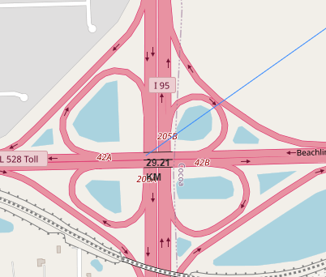
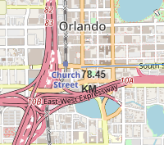
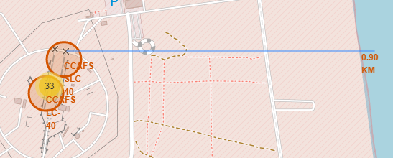
Distance Between Launch Sites and Proximities
Distance to Highway (29.21 KM)
Distance to City (78.45 KM)
Distance to Coastline (0.90 KM)
Launch sites are not very close to highways
Launch sites are not very close to major cities
Launch sites are close to coastlines

Slide 38


Slide 39
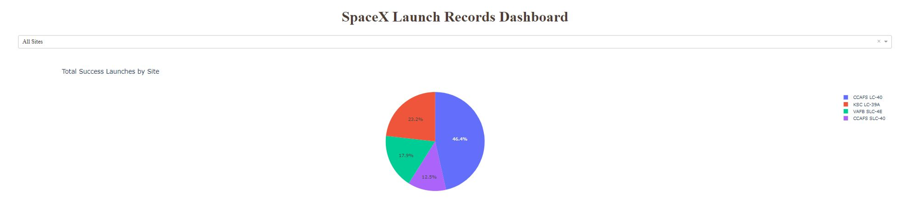
Launch Success By Site
The Pie Chart shows that CCAFS LC-40 had the highest successful launch percentage at 46.4%

Slide 40
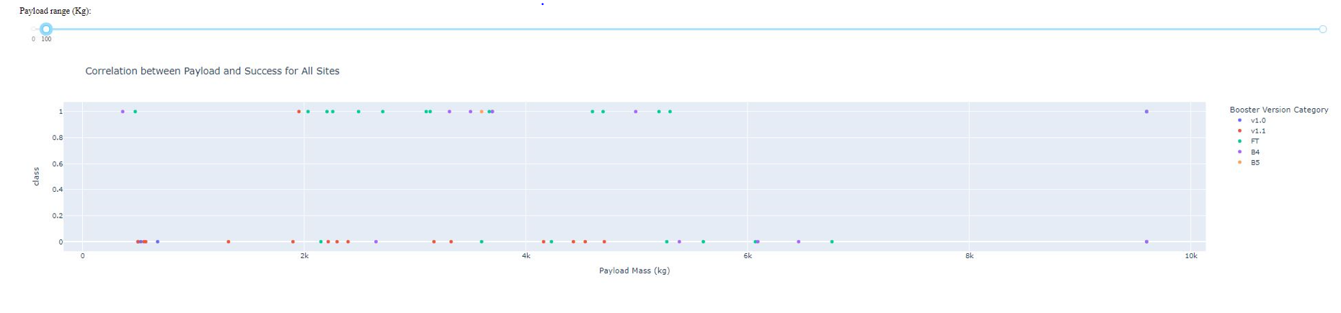
Payload Mass vs. Launch Outcome
Payload mass from 100kg to 10,000kg
In this graph it appears that lighter payloads have a higher success rate. It also looks like Booster Version “FT” has the highest success rate.

Slide 41


Slide 42
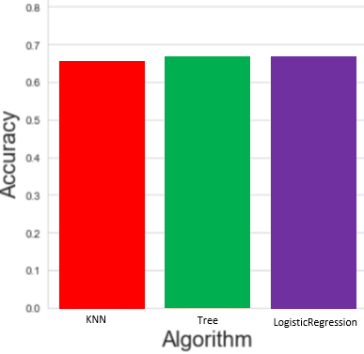
Classification Accuracy
It appears that the Tree Algorithm and the Logistic regression are tied for the highest accuracy at 66.79%

Slide 43
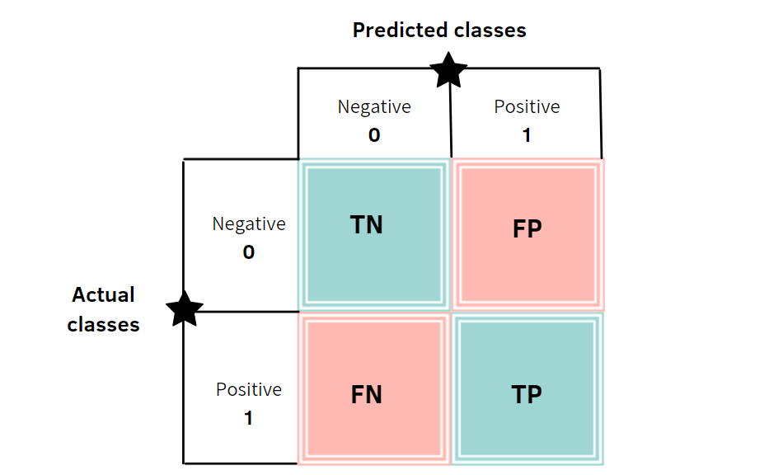
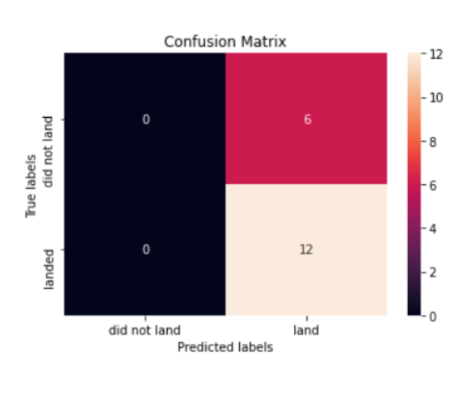
Confusion Matrix
Tree Algorithm
As you can see, the Tree algorithm does a pretty good job identifying true positives. The biggest issue with his algorithm is with false positive results

Slide 44
Conclusions
Lighter mass payloads tend to have better launch outcomes.
Booster version FT has the highest successful launch outcome
Site CCAFS LC-40 was by far the most successful launch site
The Tree algorithm and the Logistic Regression Algorithm are the most accurate when it comes to machine learning on this dataset.
There were a decent number of false positives when looking at the confusion matrix

Slide 45


